Slide 1
Exporting a Project
Jar, Zip and Runnable Jar

Slide 2
What is a jar?
JAR stands for Java ARchive.
It's a file format based on the popular ZIP file format and is used for aggregating many files into one.
Although JAR can be used as a general archiving tool, the primary motivation for its development was so that Java applets and their requisite components (.class files, images and sounds) can be downloaded to a browser in a single HTTP transaction, rather than opening a new connection for each piece.
JAR compresses the files.

Slide 3
Jar vs. Runnble Jar
The runnable jar contains a MANIFEST.MF file, which defines the Main class to be executed when the jar is run
If a jar does not include a manifest with the "Main-Class:" it is not considered a "runnable jar" - it is just a library of Java code.

Slide 4
Eclipse
Either from the context menu or from the menu bar's File menu, select Export.
Select Runnable Jar

Slide 5
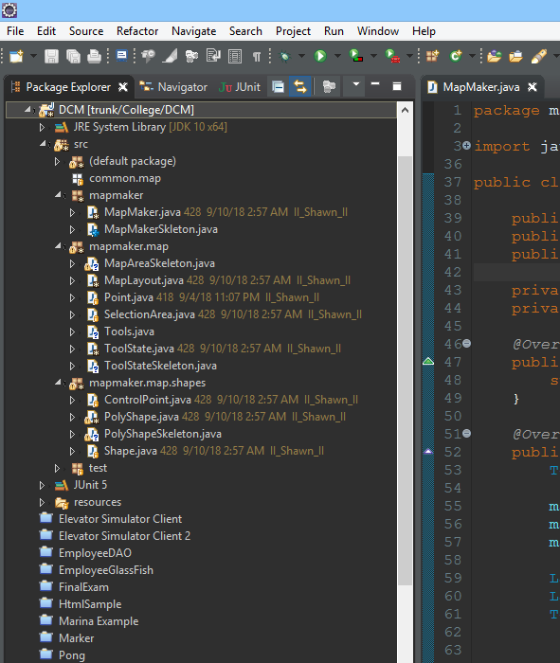
Select your project or file to be exported

Slide 6
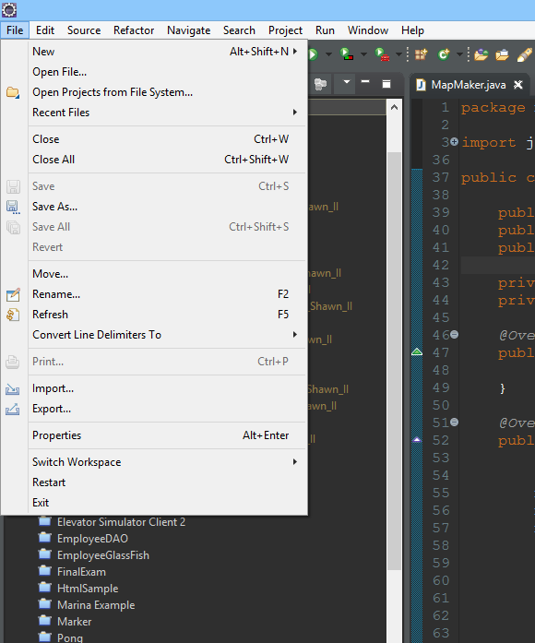
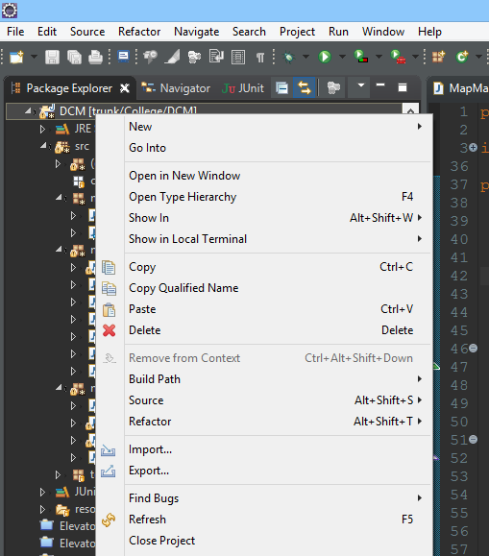
Select export either by right clicking project or clicking file menu

Slide 7
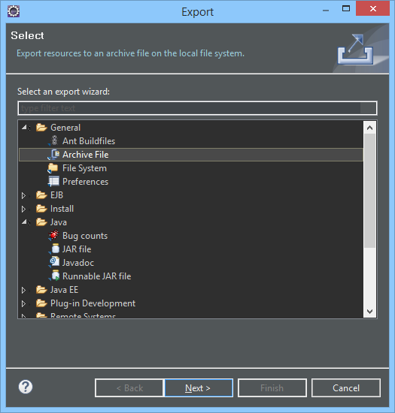
Select an option
Archive File, if you want to export as zip file
JAR File, if you want to export as Jar file that is not executable
Runnable JAR File, if you need and executable JAR File

Slide 8
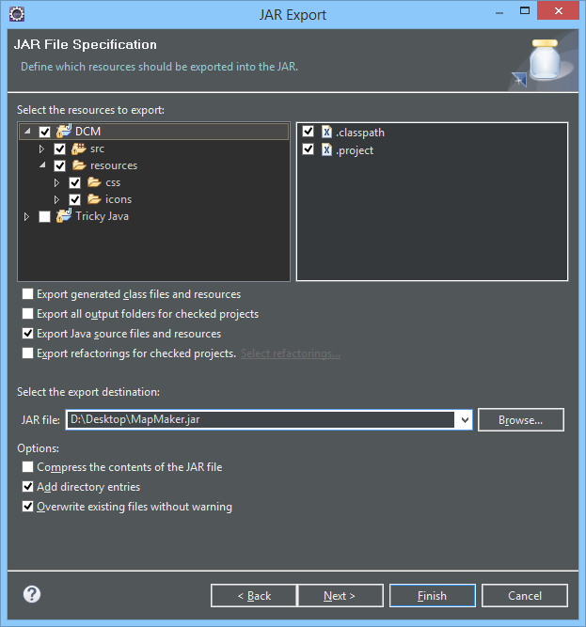
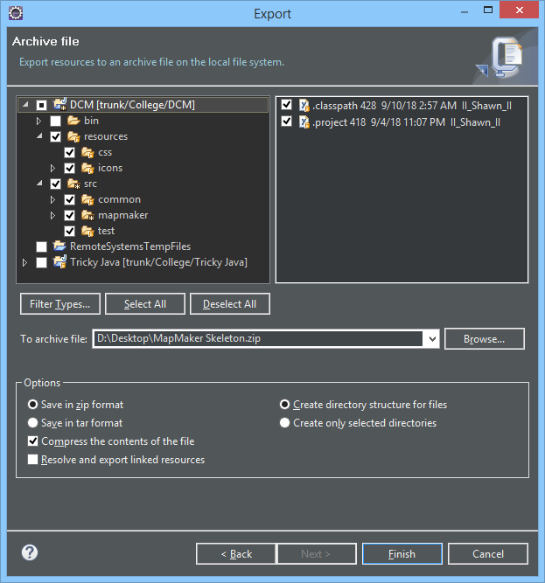
JAR and Archive File
Select Desired files and folders to be exported unless specified everything.
Only exception is bin folder which is not needed.
Browse to a desired save location and name your file and click finish

Slide 9
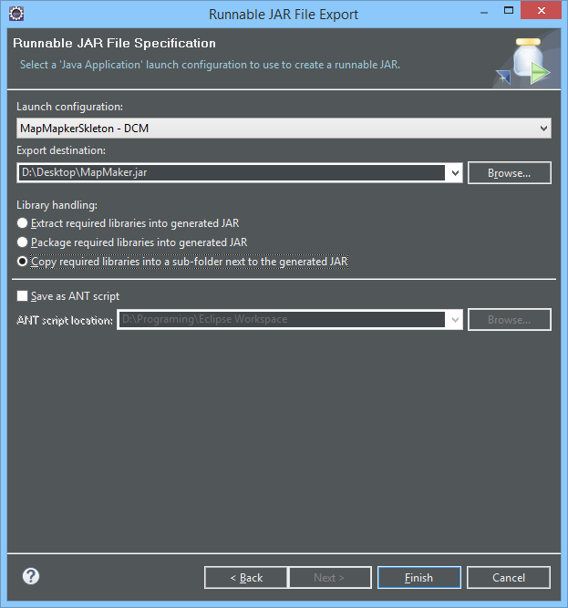
Runnable JAR File
Select Desired Launch configuration. It must start with the name of class containing main method followed by the name of your project.
Browse to a desired save location and name your file.
Only select yellow box if you added libraries that I do not have or was not part of the requirements. Junit is not required to be included when submitting.
Click finish

Slide 10
NetBeans 8.2 +
Right-click on the Project name.
Select Properties.
Click Packaging.
Check Build JAR after Compiling.
Check Compress JAR File.
Click OK to accept changes.
Right-click on a Project name.
Select Build or Clean and Build.

Slide 11
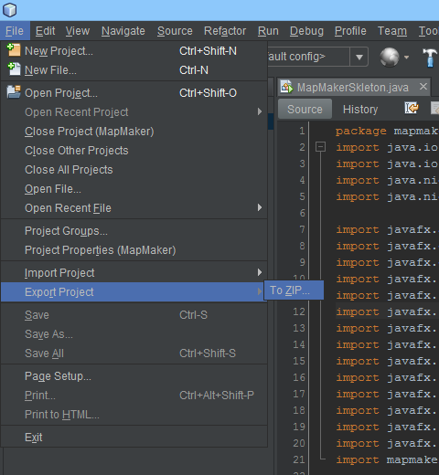
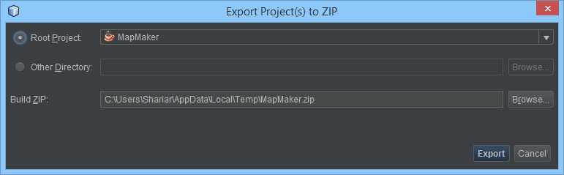
Zip File
Click file menu
Click export Project and select to ZIP
Choose Root project, name of your project
Browse to a desired location and name your zip file
Click export

Slide 12
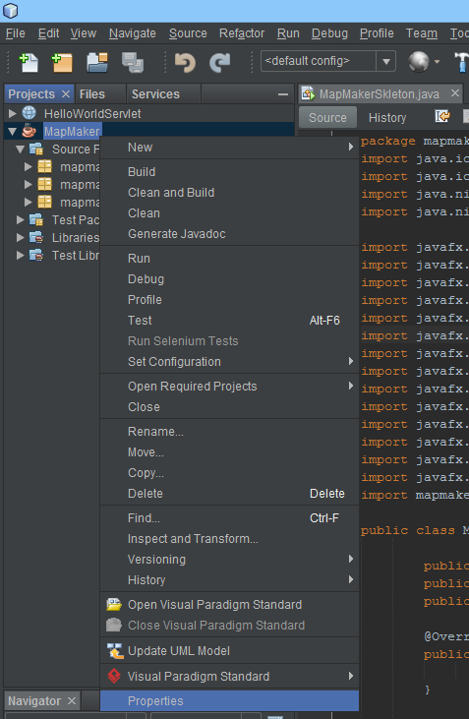
Runnable JAR File
Right Click on project and go to Properties

Slide 13
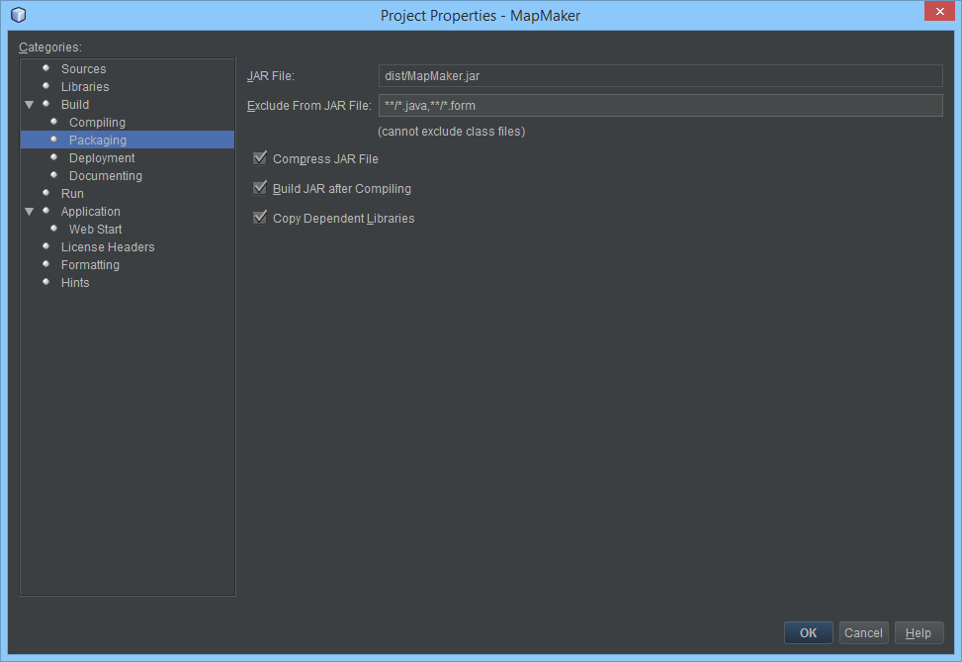
Runnable JAR File, continue
Select Packaging
Select Compress Jar File
Select Build Jar
Pay attention to save location
Click ok

Slide 14
Runnable JAR File continue
Right click on your project and Run
Right click again and Clean and Build
Finding JAR File
Navigate to where your projects is saved on your computer
In your project directory there will be folder called dist
Inside is your Runnable JAR File

Slide 15
Making a Jar from the command line
1. Make Manifest File
2. Compile all classes
3. Run Jar command

Slide 16
Make Manifest File
A manifest is a one-line text file with a "Main-Class" directive. For example:
Main-Class: DoStuff
This line must end with a newline.
Give it a name like
manifest.txt

Slide 17
Create in text editor
Give it a name like
manifest.txt

Slide 18
Creating the Jar
2. Compile all classes
3. run JDK's jar.exe utility.
It is located in the JDK’s bin folder, the same place where javac.exe and java.exe are.
jar.exe takes command-line arguments; if you run it without any arguments, it will display the usage information and examples. You need
C\mywork> jar cvfm MyJarName.jar manifest.txt *.class

